Slide 1


Slide 2
Agenda
Introduction to UiPath
What is UiPath?
Products of UiPath
Features of UiPath
How to install UiPath?
UiPath Installation

Slide 3
What is RPA
Robotic Process Automation is the technology that allows anyone today to configure computer software, or a “robot” to emulate and integrate the actions of a human interacting within digital systems to execute a business process.
Robotic process automation (RPA) is the use of software with artificial intelligence (AI) and machine learning capabilities to handle high-volume, repeatable tasks that previously required humans to perform. The main goal of Robotics process automation process to replace repetitive and boring clerical task performed by humans, with a virtual workforce.
Why RPA?
RPA holds the power to automate almost all the repetitive, mundane and rule based tasks more quickly accurately and tirelessly, compared to a human being.
It uses a machine (robot) that possesses tangible integration and automation capabilities which can mimic human interactions with web applications, web sites, portals, Excel worksheets, legacy green-screen apps, and email and helps automate the tasks.
RPA is economically efficient than any other automation solutions that exist currently.
Implementing RPA for redundant business processes also enables human beings to shift their focus from repetitive tasks to tasks requiring emotional intelligence, reasoning, judgement and interactions with the customers.

Slide 4
RPA Benefits
Reduced cost: By automating tasks, cost savings of nearly 30% can be achieved. Software robots also cost less than a full-time employee.
Better customer experience: Deploying RPA frees up your high-value resources to be put back on the front line ensuring your customer success.
Lower operational risk: By eliminating human errors such as tiredness or lack of knowledge, RPA reduces the rate of errors thereby providing a lower level of operational risk.
Improved internal processes: In order to leverage AI and RPA, companies are forced to define clear governance procedures. This, in turn, allows for faster internal reporting, on-boarding and other internal activities.
It does not replace existing IT systems: One of the biggest advantages of using a virtual workforce, or an RPA bot is that it does not require you to replace your existing systems. Instead, RPA can leverage your existing systems, the same way a human employee can.

Slide 5
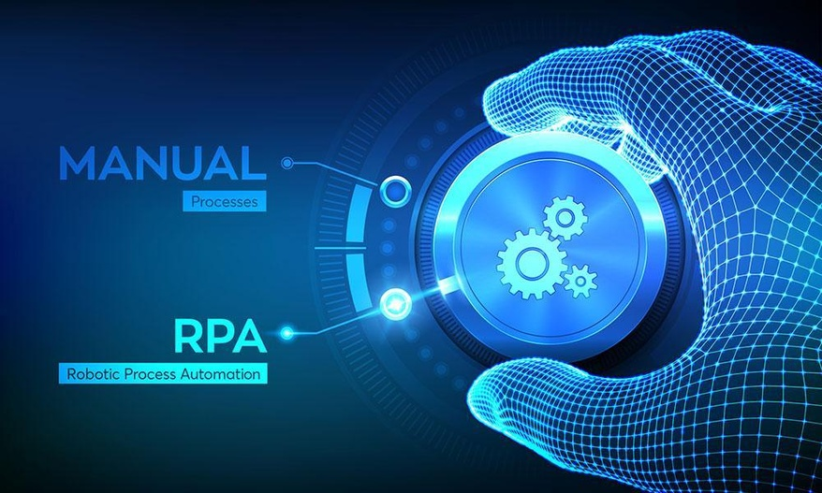
Process fit for RPA
The automation capabilities provided by RPA are ideal for tasks that are:
Repetitive
Rules-based
High volume
Do not require human judgement.
If a task checks every single one of these boxes, it’s probably a great fit for RPA.
A set of seven questions can help in process identification, if the answer to these questions is a YES:
1. Can the task be completed manually by a human sitting at a PC working with applications?
2. Does the business system lack an API or is the database behind the application inaccessible?
3. Does the core vendor charge extra for updating information in the business application?
4. Does a human worker perform the task more than once per week?
5. Does the task involve sensitive data?
6. Does the task need to be completed quickly with limited staffing resources?
7. Are there repetitive tasks that employees dislike?

Slide 6
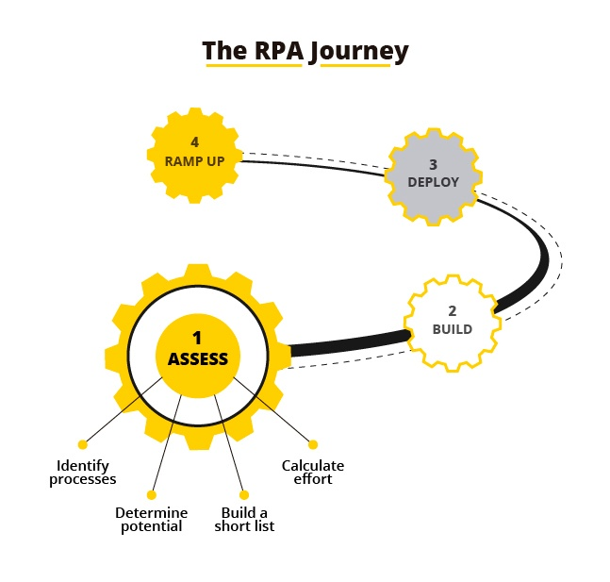
RPA Journey
Steps in a typical RPA journey
Identify the Automation Opportunities:
This should be first step of the RPA Journey,
Following area can help in identifying.
Automation opportunities.
Rule Driven Processes
Repetitive Processes
Data entry Processes
Volumes Driven Processes
Frequent human errors
Optimize the Identified Processes :
Optimize the ‘As Is’ process. Analyze the existing process
and identify the improvement areas.
Build Business Case for the RPA Journey

Slide 7
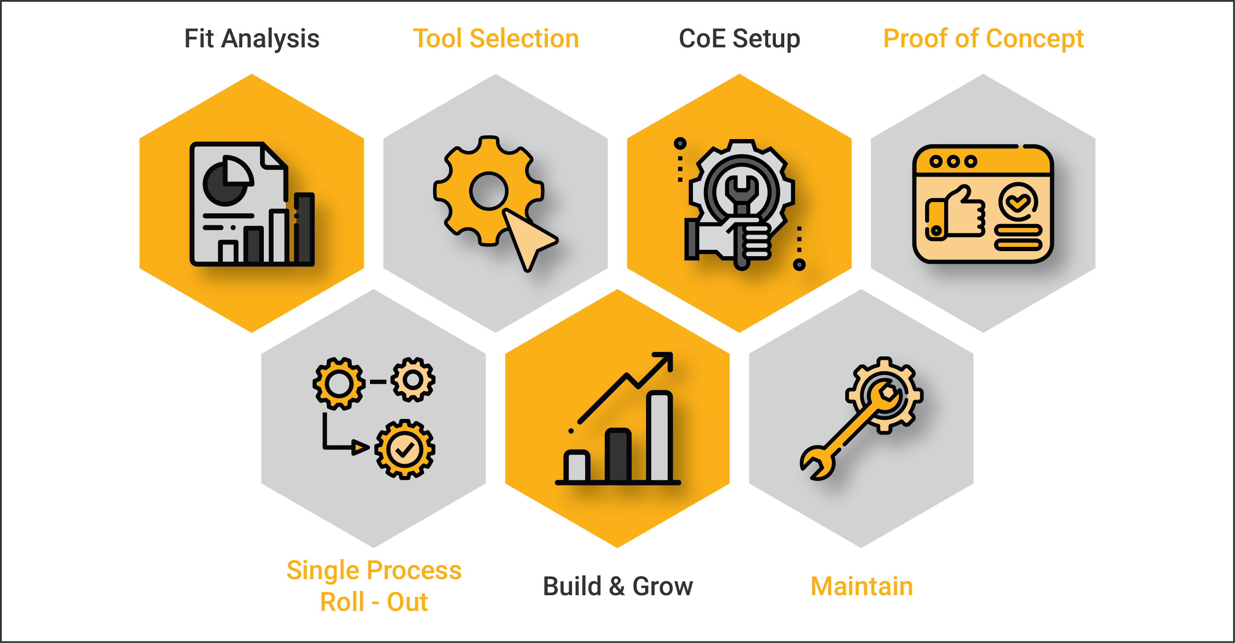
RPA Journey
RPA Vendor Selection :
Some of the factors to keep in mind while selecting RPA vendor :
Technology
Interface
Management
Security
Pricing
Pilot RPA Development :
Some of the factors need to be considered during the
pilot RPA development are:
How long should your pilot be?
Plan for the programming/development
Plan for the change management
Plan for the pilot launch
Plan for the risk management during the pilot stage.
Evaluate ‘What Went Well’ and ‘What Could Have Been Better”
Ramp up and Continue Building Expertise RPA bots

Slide 8
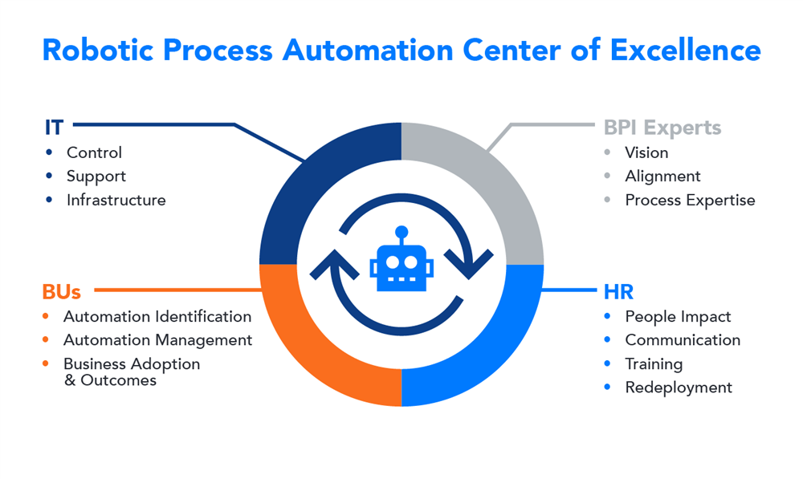
Center of Excellence
RPA Center of Excellence (CoE) helps embed automation effectively into an organization, and redistribute accumulated knowledge and resources across various business units for future deployments. Developing an RPA CoE is an important step in establishing a foundation for automation in your business.
5 core focuses in the process that must be assessed and established while making this development.
Opportunity Assessment
Build an opportunity assessment framework
Engage your business partners
Measure the ROI
Understand that mistakes WILL occur
Robotic Readiness
Drop the short term mentality
Develop through agile methodology
Set tangible goals and stick to them

Slide 9
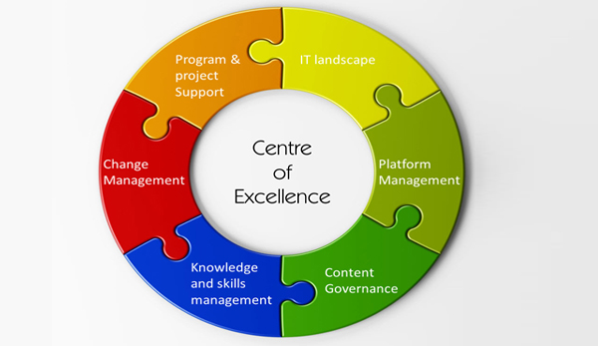
Center of Excellence
Delivery and Support
Implement an impact assessment
24-7 monitoring
Anticipate the downstream impact
Governance
Keep the core team engaged
Frequently engage the IT team
Enablement
Start small in the beginning
Implement holistically
Brace your team members

Slide 10

How RPA can increase employee productivity
When technology does the heavy lifting, as is the case with RPA, output can be significantly increased. Furthermore, knowledge workers will be freed up to apply their skills and experience to more important projects that drive innovation and growth.
Maximizes efficient use of constrained workforce – by freeing up your team to focus on customers (external or internal), and perform tasks that really add value to your organization
RPA improves productivity by achieving the optimum efficiency of the team
RPA avoids reprocessing and improves the productivity
RPA provides useful data to the team, which increases the possibility of analyzing the cause of low/poor productivity

Slide 11
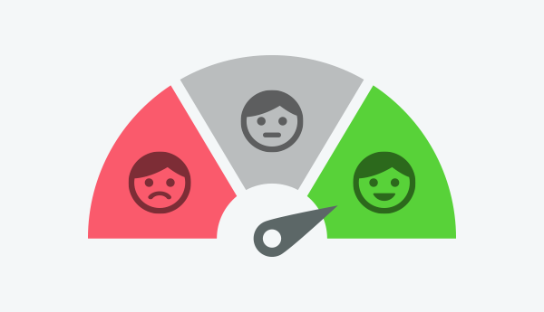
How RPA can increase Customer Satisfaction
RPA can drive customer improvements.
Through automation an organization can deliver quality services faster and decrease the chance of errors.
RPA significantly improves delivery quality by eliminating data-entry errors.
Automated tasks can even have an audit trail, so you can see what was done. This can greatly improve monitoring and governance for these kinds of processes. It also makes post-facto analysis much easier.
Customer can use robotics process automation as an intermediate automation strategy, reaping the benefits of process automation without any changes to their existing systems
Several examples of ROI gained through the enhanced customer experience enabled by RPA implementations:
Superior return on ROI.
Enhanced word of mouth for a business.
24/7 attention to customer needs.
Improved accuracy of manually-created reports.
Enhanced productivity and informed decision-making for customers.
Improved turnaround times.
Sharpening focus on value-added activities.

Slide 12
Industries using RPA
Industry | Usage
Healthcare | Patient registration Billing
HR | New employee joining formalities Payroll process Hiring shortlisted candidates
Insurance | Claims Processing & Clearance Premium Information
Manufacturing & Retail | Bills of material Calculation of Sales
Telecom | Service Order Management Quality Reporting

Slide 13
Industries using RPA
Industry | Usage
Travel & Logistic | Ticket booking Passenger Details Accounting
Banking and Financial Services | Cards activation Frauds claims Discovery
Government | Change of Address License Renewal
Infrastructure | Issues Processing Account setup and communication

